Slide 1
Success on Windows: Developing Universal Windows Platform apps for mobile
Andrew Moll

Slide 2
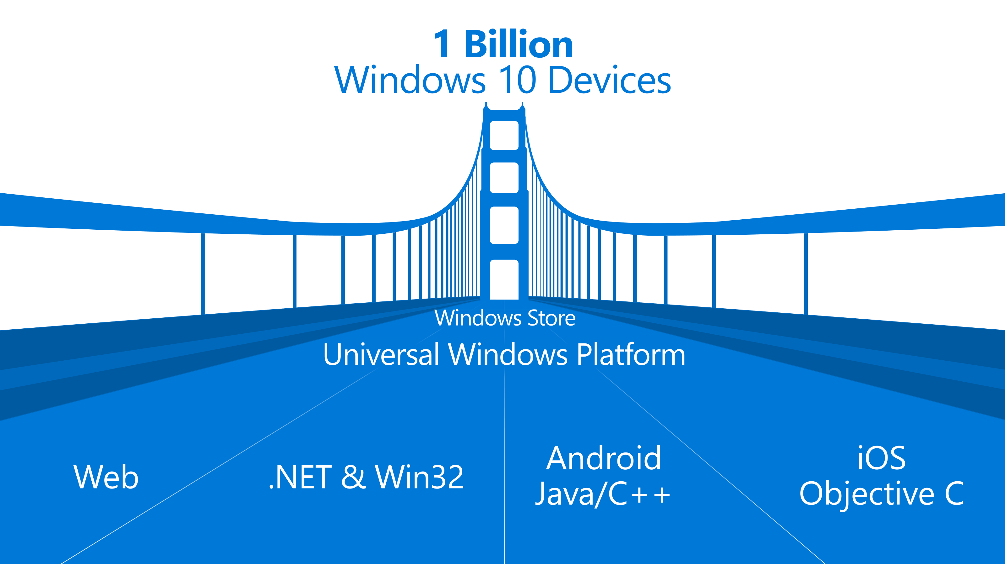

Slide 3

The convergence journey
Xbox 360
Xbox One
Unified core and app platform
Converged
OS kernel
Windows 8.1
Windows 8
Converged
app model
Windows 10
Windows Phone 8.1
Windows Phone 8
Easy for users to get & stay current
Windows Phone 7.5
Windows on Devices
Notes:
OS Kernal allowed for multi core etc. But win 8.1 had similar but not identical across. They were using Silverlight which we still don’t really use
Now nirvana with win 10 which is the truly converged dev platform.

Slide 4

Introducing the UWP

Slide 5
Windows Core
The refactored common core
One hardware platform
Universal hardware driver
Standard network and I/O
Desktop SKU
Phone SKU
Xbox SKU
Windows Core
Desktop
Device
Phone
Device
Xbox
Device
Notes:
Windows core. What we install all over is really just the same version of windows.

Slide 6
One Windows
Desktop SKU
Mobile SKU
Xbox SKU
IoT SKU
IoT headless SKU
Surface Hub SKU
Holographic SKU
PC
2 in 1
Tablet
Phablet
Phone
Xbox
Band
Raspberry Pi
Surface Hub
HoloLens
Home Automation
Notes:
7 different products for now. We have the ability to bring in future products.

Slide 7
Test capabilities at runtime
Use Adaptive Code to light-up your app on specific devices
var api = "Windows.Phone.UI.Input.HardwareButtons";
if (Windows.Foundation.Metadata.ApiInformation.IsTypePresent(api))
{
Windows.Phone.UI.Input.HardwareButtons.CameraPressed += CameraButtonPressed;
}
Notes:
Not a # if statement where if x build y but it’s actually the same app with a single bianary
And so that is the Universal Windows Platform

Slide 8
Microsoft design language principles
Keep it Simple Isn’t it nice when things just work, when the next step is intuitive, and people are inspired? | Make it Personal We design for real people, not requiring people can fit into our design. Personal means human.
Think Universal Better technology for anyone is better technology for everyone. It’s an attitude. | Create Delight Attention of detail equals moments of delight. Sometimes delight is so perfect it is invisible.
Design as One Work together and do amazing things. Many teams, one ecosystem, happy customers.

Slide 9
For most text, use 15 epx Segoe UI Regular

Slide 10
Physical versus effective pixel
4” Phone
480x854
4” Phone
480x854
5” Phone
720x1280
5” Phone
720x1280
6” Phone
1080x1920
6” Phone
1080x1920

Slide 11
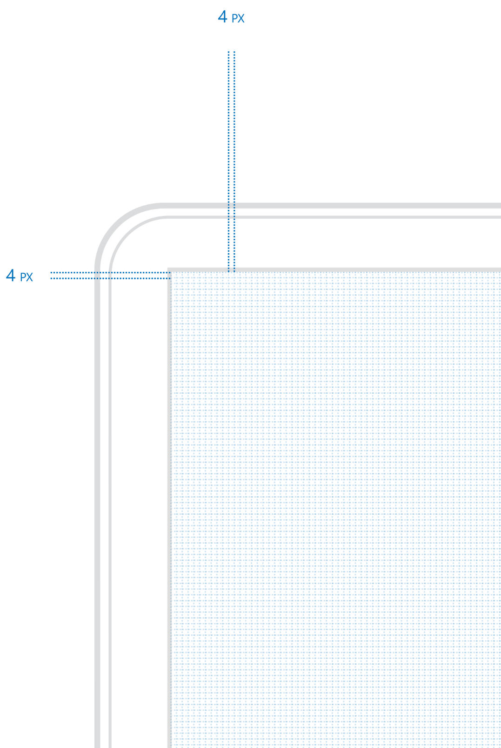
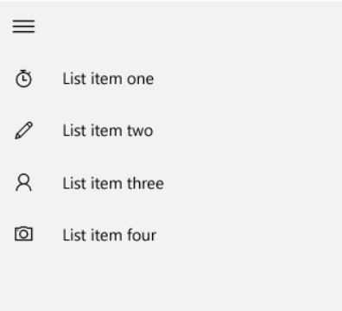
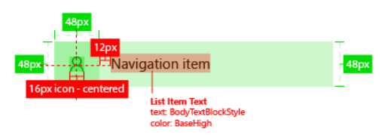
Four is the magic number

Slide 12
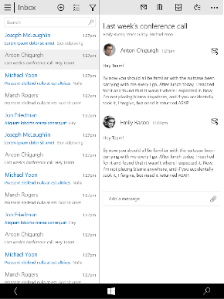
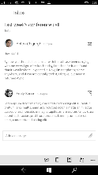
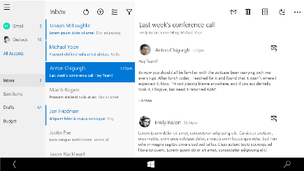
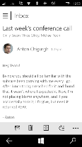
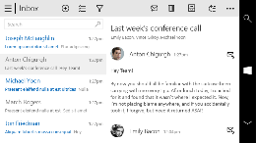
Snap points
epx
320
548
720
1024
phone
phablet & tablet
desktop
limited landscape support
one frame at a time
sys tray on the left
steering wheel on the right
4+ actions on the bottom
tabs are centered
limited landscape support
one frame at a time
sys tray on the left
steering wheel on the right
4+ actions on the bottom
single column stops scaling
tabs are centered
full landscape support
two frames
actions at the top
one “…” visible - TBD
tabs are left aligned
Show search field if search was represented as an icon on smaller devices
full landscape support
three frames
compact nav pane
actions at the top
one “…” visible
tabs left aligned

Slide 13
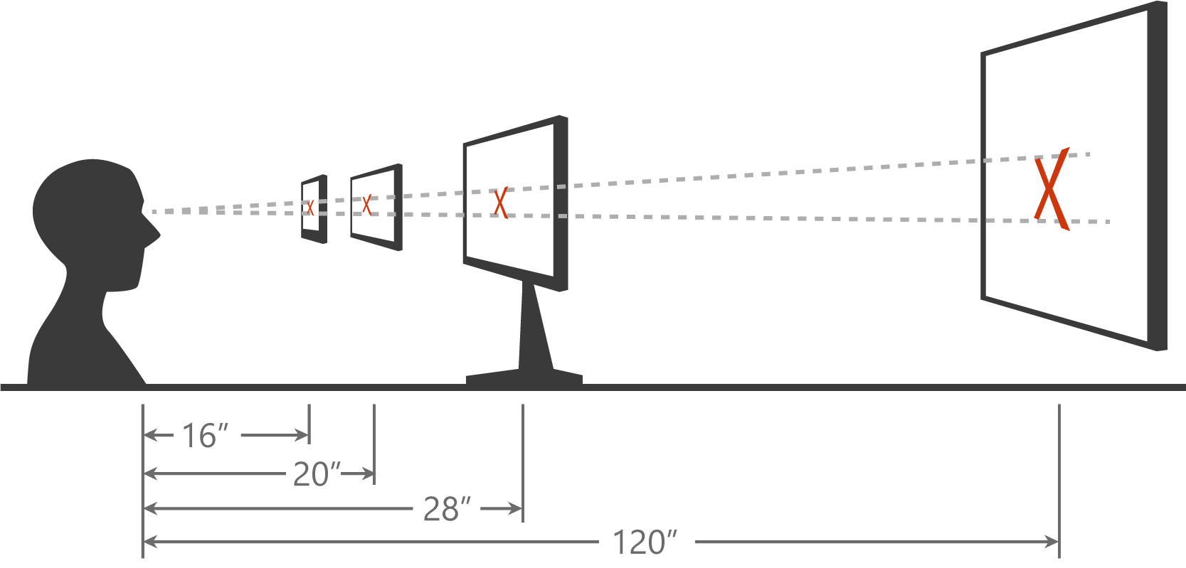
Scaling algorithm

Slide 14
As you design
Adapt to size change
Adapt to input change
Build with effective pixels
Count on the scaling algorithm

Slide 15
Techniques to adapt

Slide 16
Adaptive design
Responsive design
Flexible layout responds to small changes
Many controls handle basic responsiveness
Adaptive design
Smart layout adjusts to large changes
Features like visual states aid in this design
Tailored design
A device-specific app can simplify design
Some devices have unique design languages
Notes:
Responsive design: use % not pixels

Slide 17
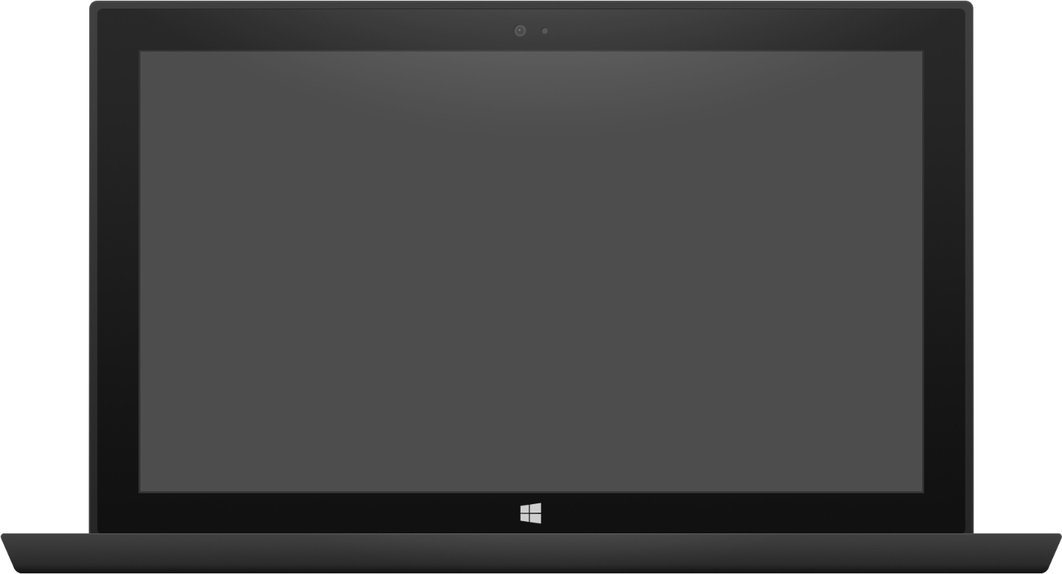

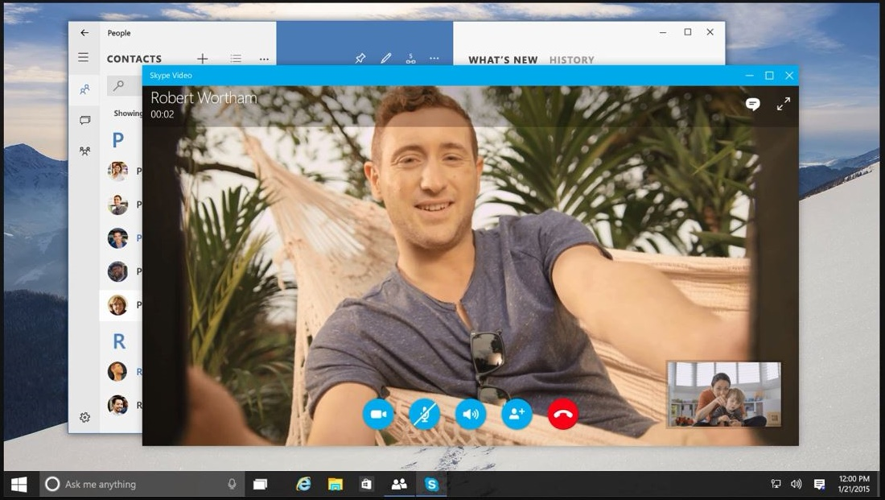
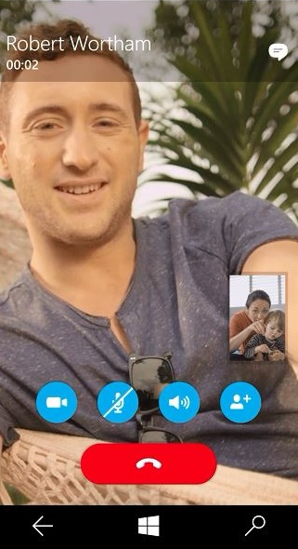
Adaptive design
Tablet (landscape) / Desktop
Phone (portrait)

Slide 18
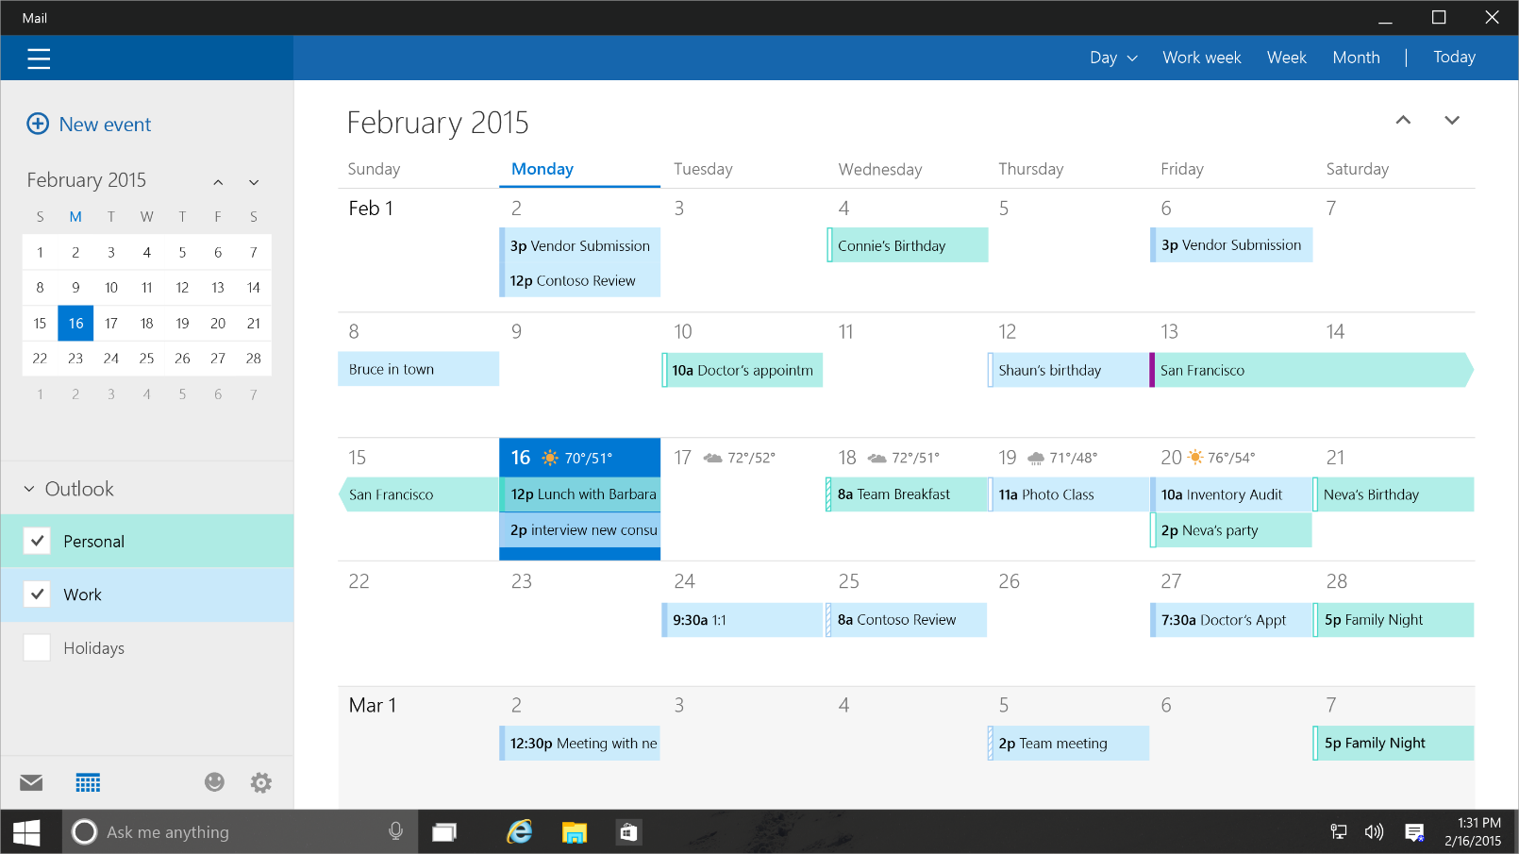
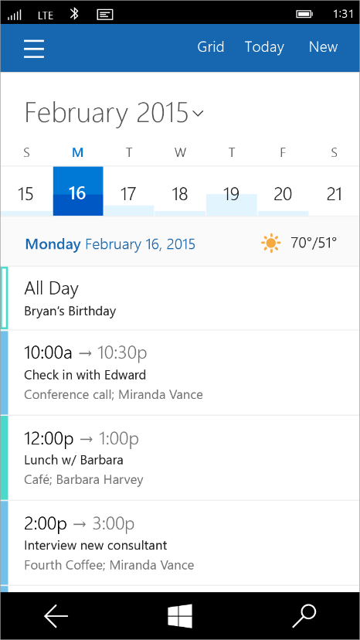
Tailored design
Tablet (landscape) / Desktop
Phone (portrait)

Slide 19
Adaptive UI

Slide 20
Universal Windows Platform
Wherever your code was born, you can bring it to Windows
Other Mobile Platforms
Project Astoria
Use your Java / C++ code
Use Android IDE
High code reuse
Project Islandwood
Use your Objective C code
Use Visual Studio
Medium-high code reuse

Slide 21
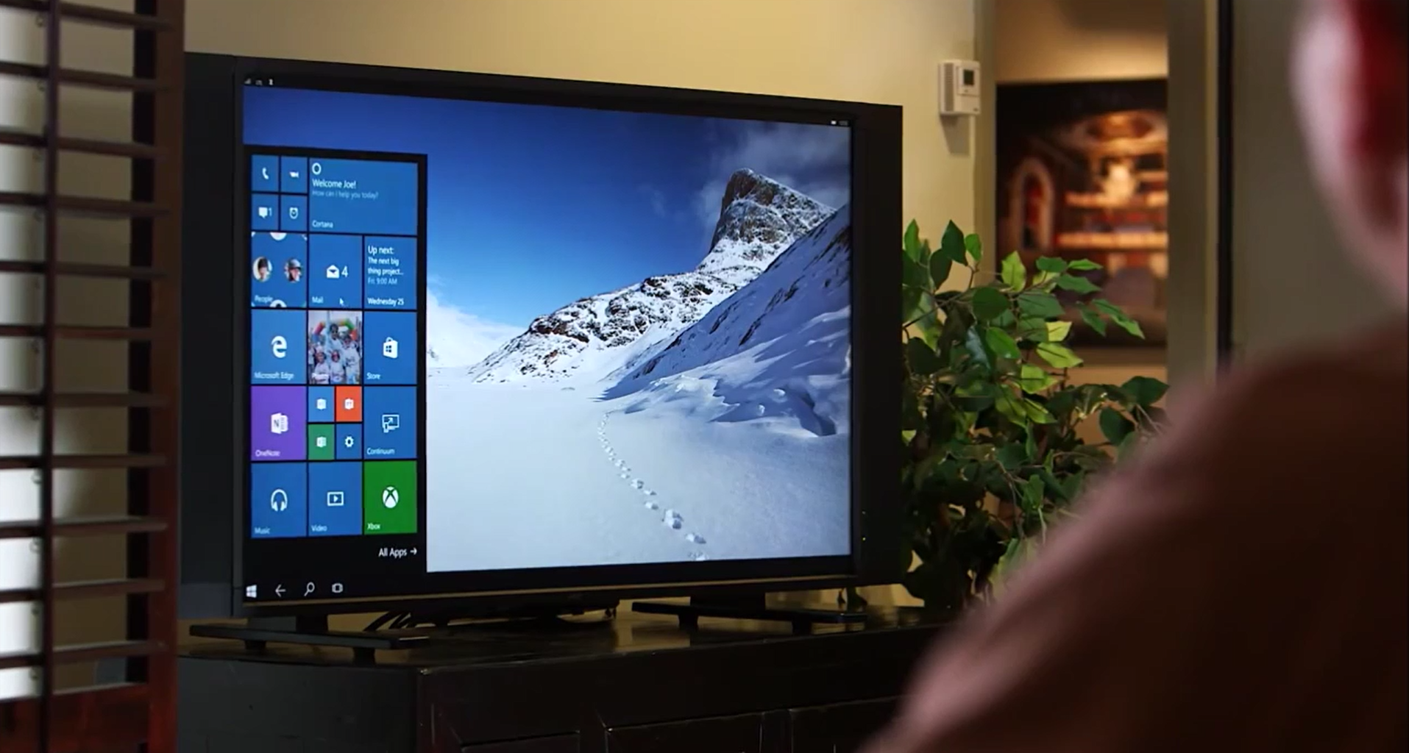
Continuum for Convertibles and Phones
Continuum for convertibles and Phones

Slide 22


Online Microsoft training delivered by experts to help technologists continually learn
Hundreds of courses for developers, IT Pros, students, entrepreneurs and enthusiasts
11 different languages
3M students registered
Build your own Learning Plan
All free!
http://www.microsoftvirtualacademy.com

Slide 23
Technical Resources for Windows Devs
Visual Studio Community Edition (free): http://aka.ms/vsc2013
Ultimate Guide & FAQ to Setting-up a Windows Phone Dev Environment: http://aka.ms/wpdevsetup
Building Apps for Windows Blog: http://blogs.windows.com/buildingapps
Dvlup Challenges & Rewards: www.dvlup.com
Microsoft App Studio: http://appstudio.windows.com
Nick Landry’s Blog: www.AgeofMobility.com
Windows Phone Developer Magazine (online): http://flip.it/95YFG
Windows Phone 8.1 Jump Start Training: http://aka.ms/wp81js
Windows 8.1 Universal Apps Samples Pack https://code.msdn.microsoft.com/windowsapps/Universal-Windows-app-cb3248c3

Slide 24

Thank You!
Contact me and let me know what you build, I will be happy to help promote your projects.
Blog: www.AndrewSMoll.com
Twitter: @AskTheData
Email: Andrew.Moll@microsoft.com
LinkedIn: www.linkedin.com/in/andrewmoll
GitHub: github.com/AndrewMoll

